Slide 1
Consumer Products Industry CBM Map
In presentation mode, click on a component to view activity-level detail
 | Consumer Relationship | Customer Relationship | Manufacturing | Inventory and Distribution | Business Administration
Direct
Control
Execute
Category/Brand Strategy
Customer Relationship Strategy
Manufacturing Strategy
Supply Chain Strategy
Corporate Strategy
Supplier Relationship Management
Inventory Planning
Corporate Planning
Category/Brand Planning
Customer Relationship Planning
Alliance Management
Network & Asset Configuration
Corporate Governance
Production/Materials Development & Planning
Brand P&L Management
Assessing Customer Satisfaction
Distribution Oversight
Business Performance Management
Matching Supply and Demand
Customer Insights
Manufacturing Oversight
External Market Analysis
Inbound Trans-portation
Outbound Trans-portation
Marketing Development and Effectiveness
Organization and Process Design
Account Management
Supplier Control
Legal, Tax and Regulatory Compliance
Product Ideation
Product/Component Manufacturing
Treasury & Risk Mgmt
Concept/Product Testing
Value-Added Services
Distribution Center Operations
Financial Accounting & Reporting
Product Development
Assemble/Pkg. Products
Customer Account Servicing
Indirect Procurement
Product Management
Retail Marketing Execution
Plant Inventory Management
Facilities & Equip Mgmt
Marketing Execution
Transportation Resources
In-store Inventory Mgmt
Resource Development
Consumer Service
Manufacturing Procurement
En route Inventory Management
HR Administration
Product Directory
Customer Directory
IT Systems & Operations

Slide 2

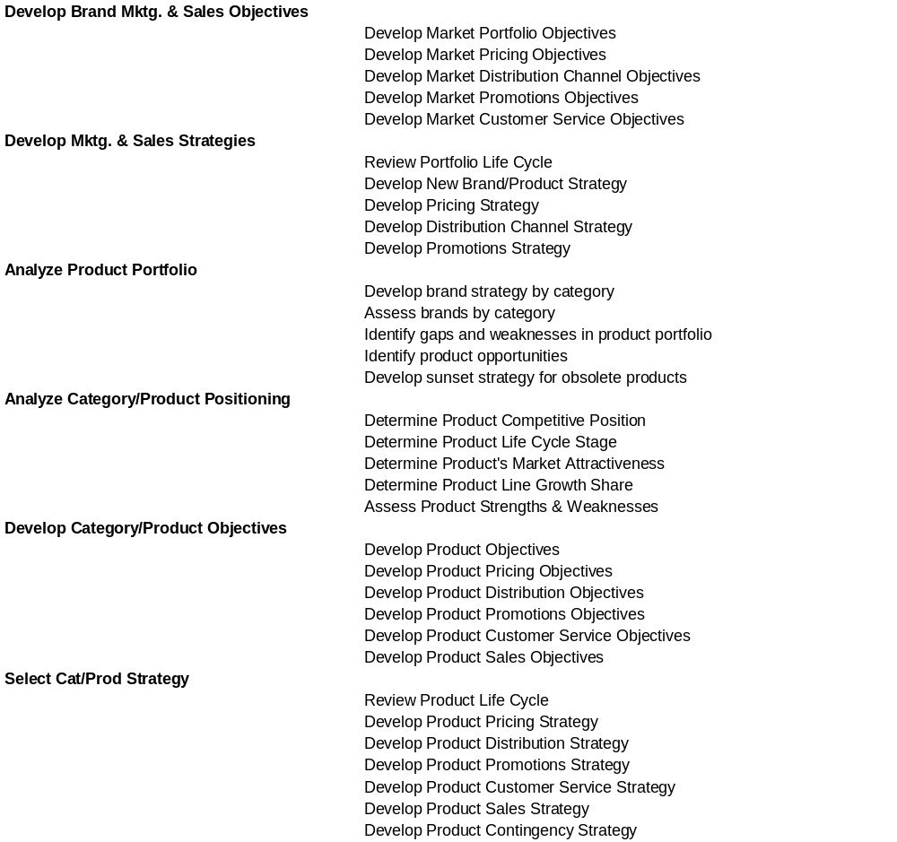
Category/Brand Strategy
Return to Map
Consumer Relationship
Category/Brand Strategy
Category/Brand Planning
Brand P&L Management
Matching Supply and Demand
Marketing Development and Effectiveness
Product Ideation
Concept/Product Testing
Product Development
Product Management
Marketing Execution
Consumer Service
Product Directory

Slide 3
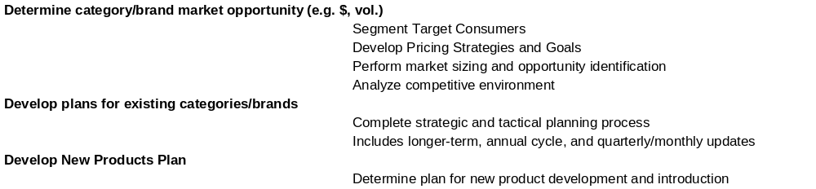
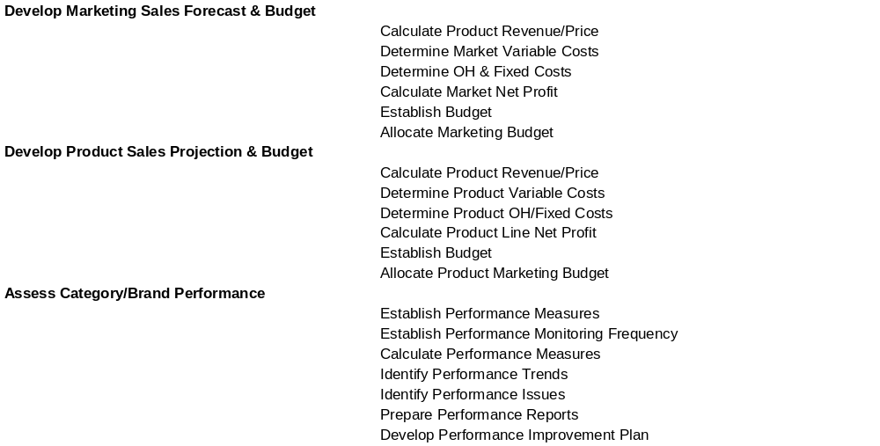
Category/Brand Planning
Brand P&L Management
Return to Map
Consumer Relationship
Category/Brand Strategy
Category/Brand Planning
Brand P&L Management
Matching Supply and Demand
Marketing Development and Effectiveness
Product Ideation
Concept/Product Testing
Product Development
Product Management
Marketing Execution
Consumer Service
Product Directory

Slide 4
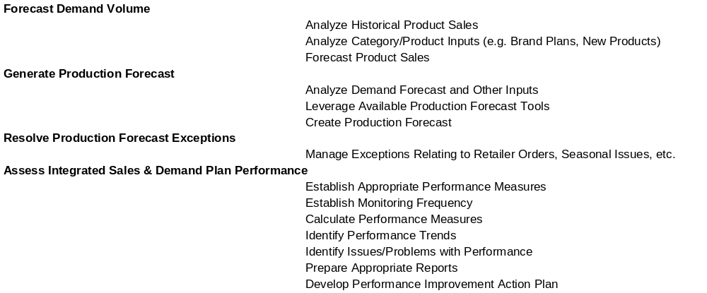
Matching Supply & Demand
Return to Map
Consumer Relationship
Category/Brand Strategy
Category/Brand Planning
Brand P&L Management
Matching Supply and Demand
Marketing Development and Effectiveness
Product Ideation
Concept/Product Testing
Product Development
Product Management
Marketing Execution
Consumer Service
Product Directory

Slide 5
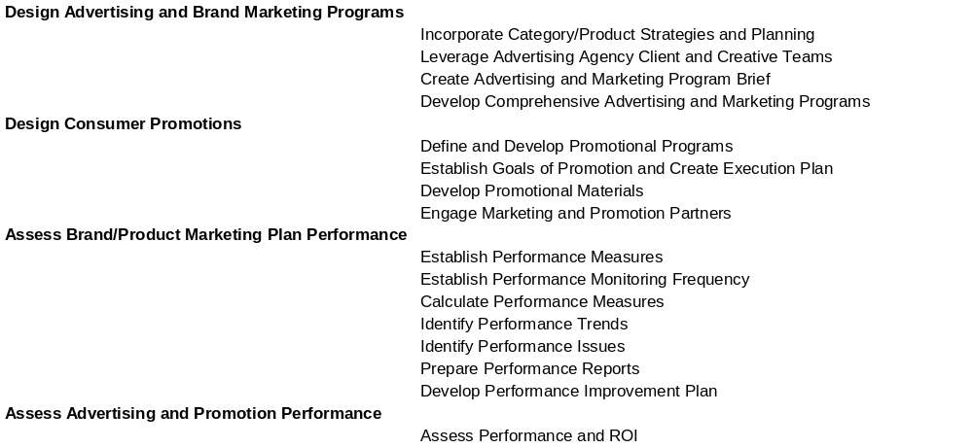
Marketing Development & Effectiveness
Return to Map
Consumer Relationship
Category/Brand Strategy
Category/Brand Planning
Brand P&L Management
Matching Supply and Demand
Marketing Development and Effectiveness
Product Ideation
Concept/Product Testing
Product Development
Product Management
Marketing Execution
Consumer Service
Product Directory

Slide 6
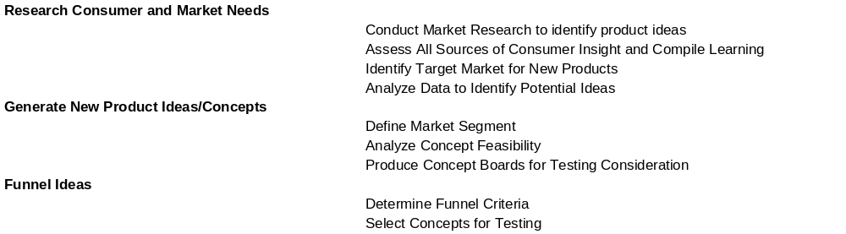
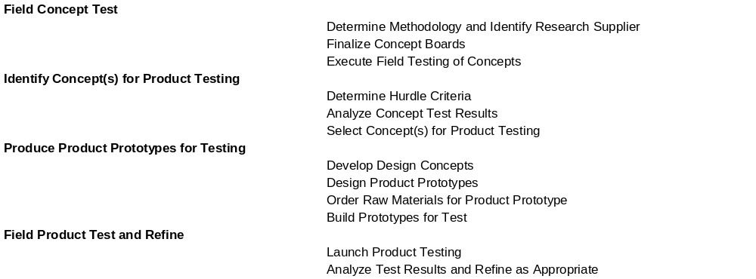
Product Ideation
Concept/Product Testing
Return to Map
Consumer Relationship
Category/Brand Strategy
Category/Brand Planning
Brand P&L Management
Matching Supply and Demand
Marketing Development and Effectiveness
Product Ideation
Concept/Product Testing
Product Development
Product Management
Marketing Execution
Consumer Service
Product Directory

Slide 7
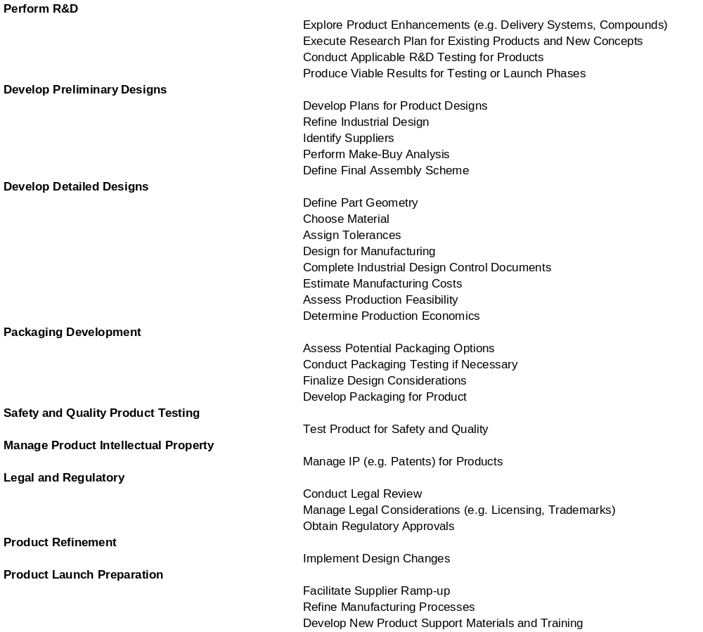
Product Development
Return to Map
Consumer Relationship
Category/Brand Strategy
Category/Brand Planning
Brand P&L Management
Matching Supply and Demand
Marketing Development and Effectiveness
Product Ideation
Concept/Product Testing
Product Development
Product Management
Marketing Execution
Consumer Service
Product Directory

Slide 8
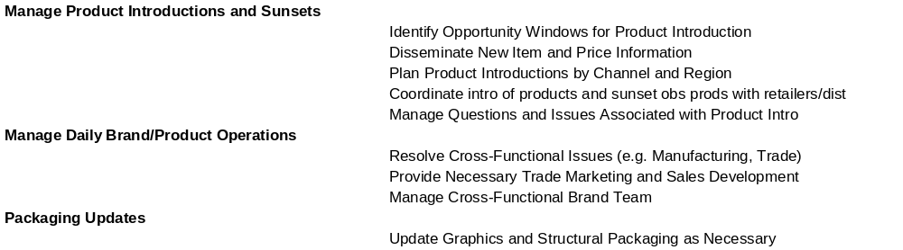
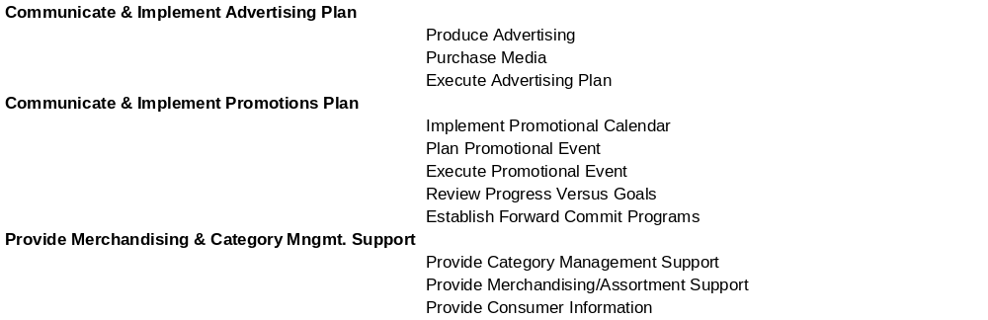
Product Management
Marketing Execution
Return to Map
Consumer Relationship
Category/Brand Strategy
Category/Brand Planning
Brand P&L Management
Matching Supply and Demand
Marketing Development and Effectiveness
Product Ideation
Concept/Product Testing
Product Development
Product Management
Marketing Execution
Consumer Service
Product Directory

Slide 9
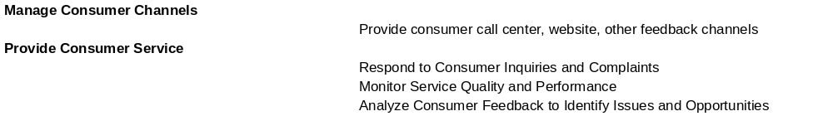
Consumer Service
Product Directory
Return to Map
Consumer Relationship
Category/Brand Strategy
Category/Brand Planning
Brand P&L Management
Matching Supply and Demand
Marketing Development and Effectiveness
Product Ideation
Concept/Product Testing
Product Development
Product Management
Marketing Execution
Consumer Service
Product Directory

Slide 10

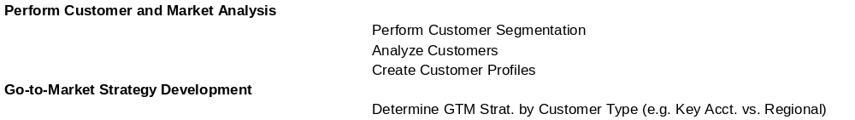
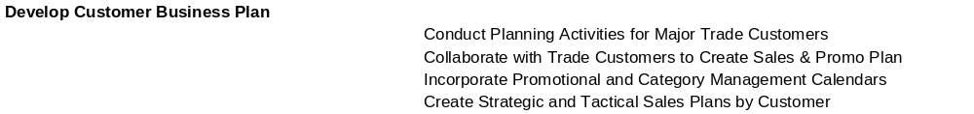
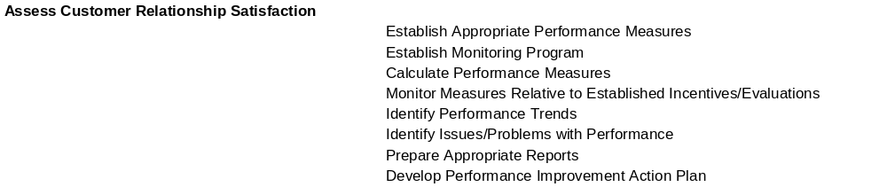
Customer Relationship Strategy, Customer Relationship
Planning, Assessing Customer Satisfaction, Customer Insights
Return to Map
Customer Relationship
Customer Relationship Strategy
Customer Relationship Planning
Assessing Customer Satisfaction
Customer Insights
Account Management
Value-Added Services
Customer Account Servicing
Retail Marketing Execution
In-store Inventory Mgmt
Customer Directory

Slide 11
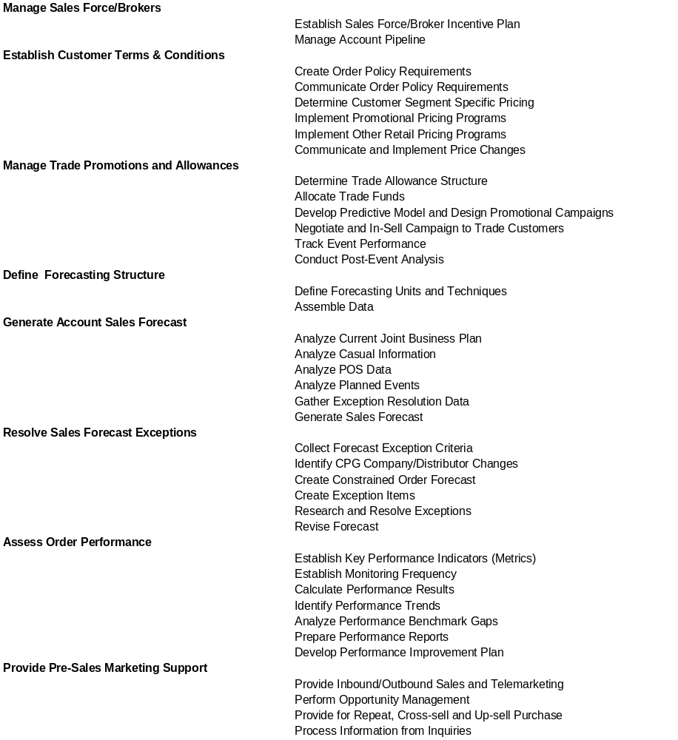
Account Management
Return to Map
Customer Relationship
Customer Relationship Strategy
Customer Relationship Planning
Assessing Customer Satisfaction
Customer Insights
Account Management
Value-Added Services
Customer Account Servicing
Retail Marketing Execution
In-store Inventory Mgmt
Customer Directory

Slide 12
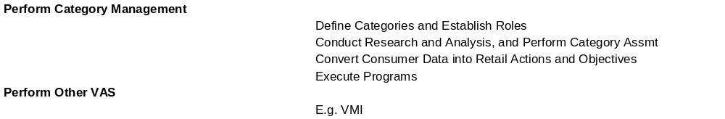
Value-Added Services
Return to Map
Customer Relationship
Customer Relationship Strategy
Customer Relationship Planning
Assessing Customer Satisfaction
Customer Insights
Account Management
Value-Added Services
Customer Account Servicing
Retail Marketing Execution
In-store Inventory Mgmt
Customer Directory

Slide 13
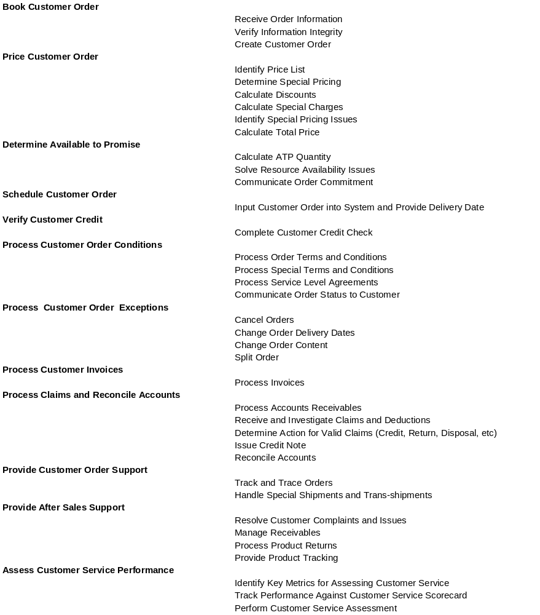
Customer Account Servicing
Return to Map
Customer Relationship
Customer Relationship Strategy
Customer Relationship Planning
Assessing Customer Satisfaction
Customer Insights
Account Management
Value-Added Services
Customer Account Servicing
Retail Marketing Execution
In-store Inventory Mgmt
Customer Directory

Slide 14
Retail Marketing Execution, In-Store Inventory
Management, Customer Directory
Return to Map
Customer Relationship
Customer Relationship Strategy
Customer Relationship Planning
Assessing Customer Satisfaction
Customer Insights
Account Management
Value-Added Services
Customer Account Servicing
Retail Marketing Execution
In-store Inventory Mgmt
Customer Directory

Slide 15

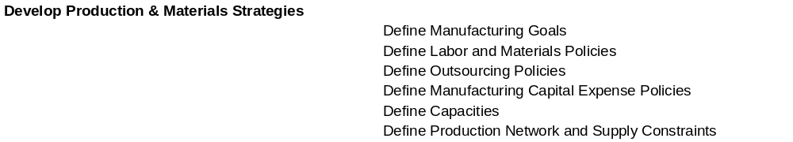
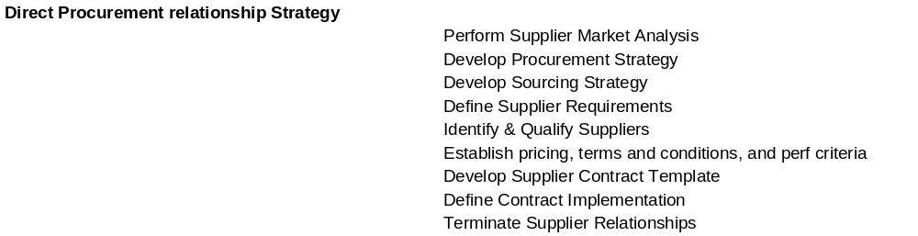
Manufacturing Strategy
Supplier Relationship Management
Return to Map
Manufacturing
Manufacturing Strategy
Supplier Relationship Management
Production/Materials Development & Planning
Manufacturing Oversight
Supplier Control
Product/Component Manufacturing
Assemble/Pkg. Products
Plant Inventory Management
Manufacturing Procurement

Slide 16
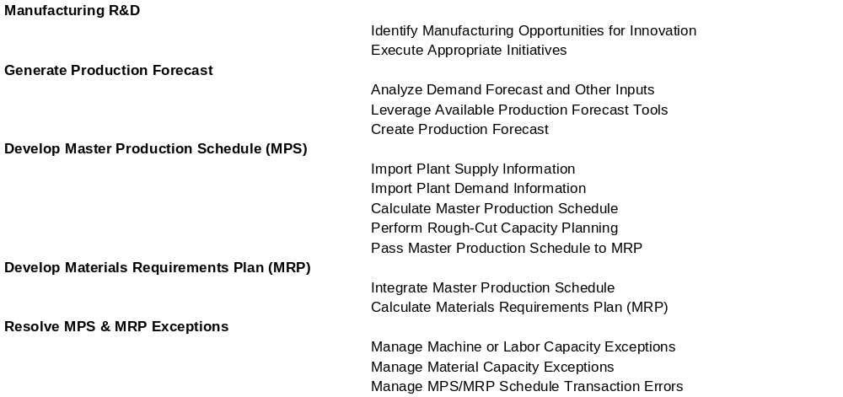
Production/Materials Development & Planning
Return to Map
Manufacturing
Manufacturing Strategy
Supplier Relationship Management
Production/Materials Development & Planning
Manufacturing Oversight
Supplier Control
Product/Component Manufacturing
Assemble/Pkg. Products
Plant Inventory Management
Manufacturing Procurement

Slide 17
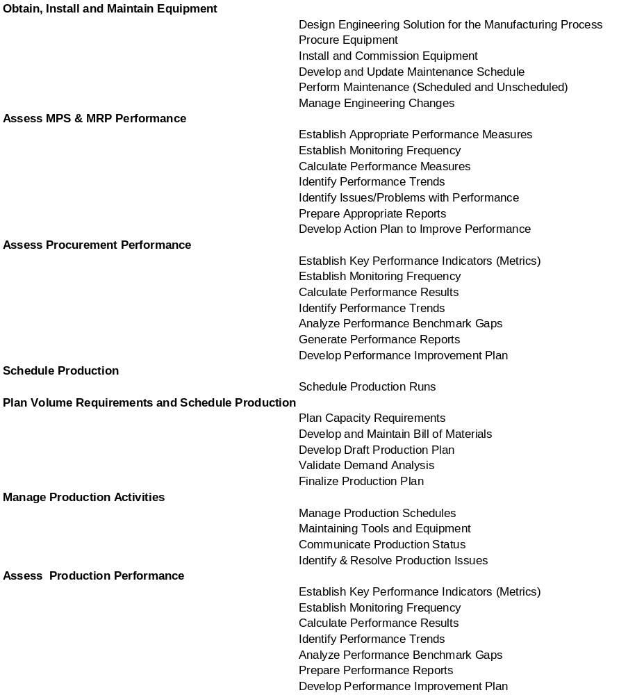
Manufacturing Oversight
Return to Map
Manufacturing
Manufacturing Strategy
Supplier Relationship Management
Production/Materials Development & Planning
Manufacturing Oversight
Supplier Control
Product/Component Manufacturing
Assemble/Pkg. Products
Plant Inventory Management
Manufacturing Procurement

Slide 18
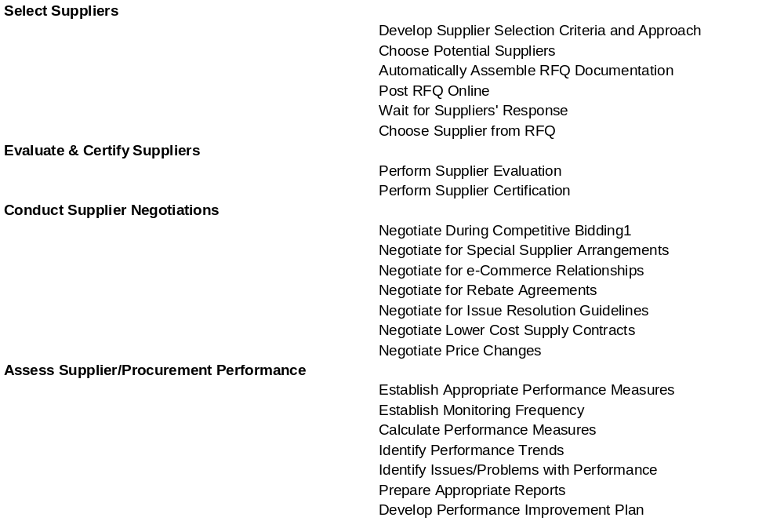
Supplier Control
Return to Map
Manufacturing
Manufacturing Strategy
Supplier Relationship Management
Production/Materials Development & Planning
Manufacturing Oversight
Supplier Control
Product/Component Manufacturing
Assemble/Pkg. Products
Plant Inventory Management
Manufacturing Procurement

Slide 19
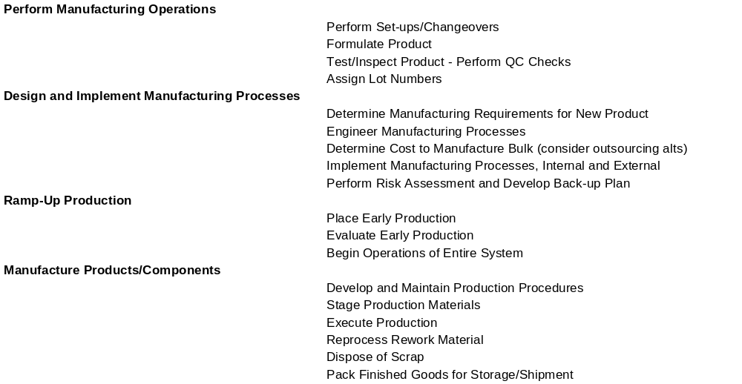
Product/Component Manufacturing
Assemble/Package Products
Return to Map
Manufacturing
Manufacturing Strategy
Supplier Relationship Management
Production/Materials Development & Planning
Manufacturing Oversight
Supplier Control
Product/Component Manufacturing
Assemble/Pkg. Products
Plant Inventory Management
Manufacturing Procurement

Slide 20
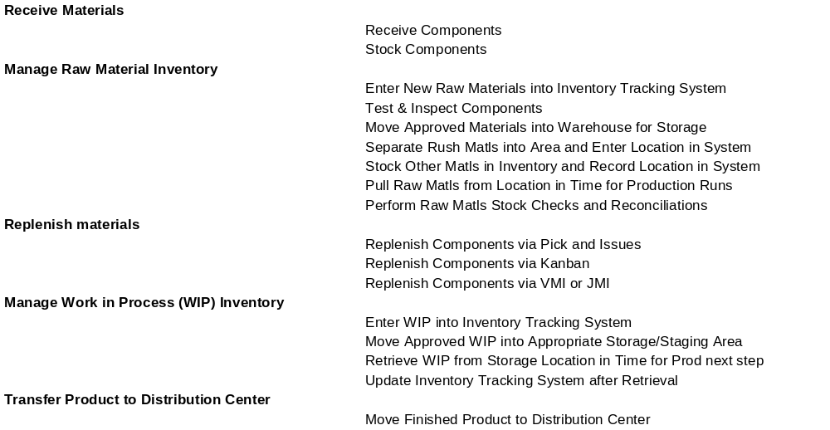
Plant Inventory Management
Return to Map
Manufacturing
Manufacturing Strategy
Supplier Relationship Management
Production/Materials Development & Planning
Manufacturing Oversight
Supplier Control
Product/Component Manufacturing
Assemble/Pkg. Products
Plant Inventory Management
Manufacturing Procurement

Slide 21
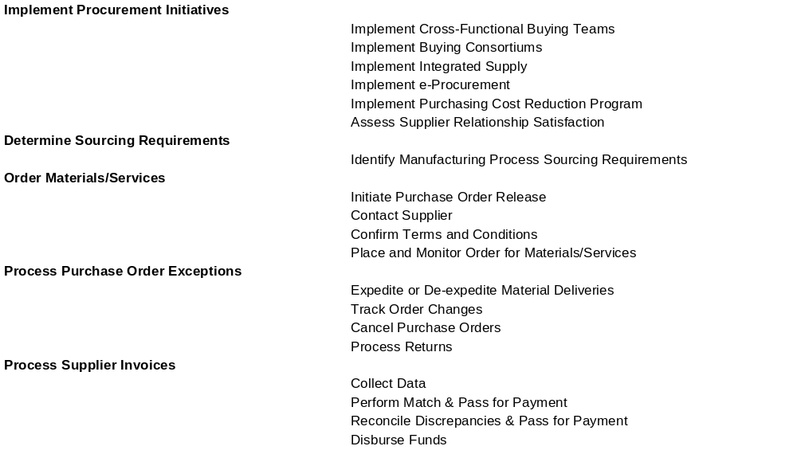
Manufacturing Procurement
Return to Map
Manufacturing
Manufacturing Strategy
Supplier Relationship Management
Production/Materials Development & Planning
Manufacturing Oversight
Supplier Control
Product/Component Manufacturing
Assemble/Pkg. Products
Plant Inventory Management
Manufacturing Procurement

Slide 22

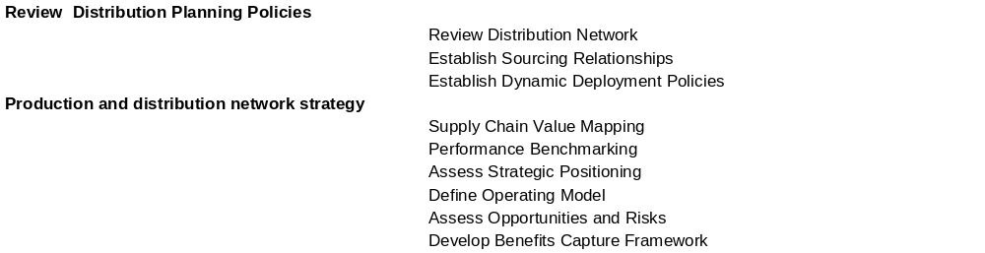
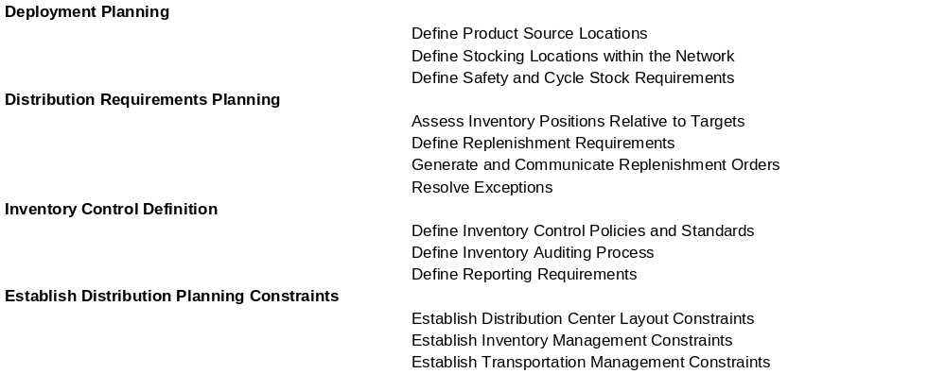
Supply Chain Strategy
Inventory Planning
Return to Map
Inventory and Distribution
Supply Chain Strategy
Inventory Planning
Network & Asset Configuration
Distribution Oversight
Inbound Trans-portation
Outbound Trans-portation
Distribution Center Operations
Transportation Resources
En route Inventory Management

Slide 23
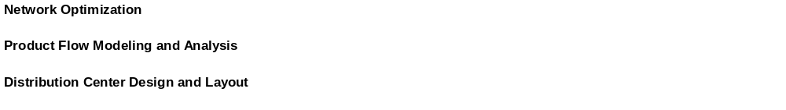
Network & Asset Configuration
Return to Map
Inventory and Distribution
Supply Chain Strategy
Inventory Planning
Network & Asset Configuration
Distribution Oversight
Inbound Trans-portation
Outbound Trans-portation
Distribution Center Operations
Transportation Resources
En route Inventory Management

Slide 24
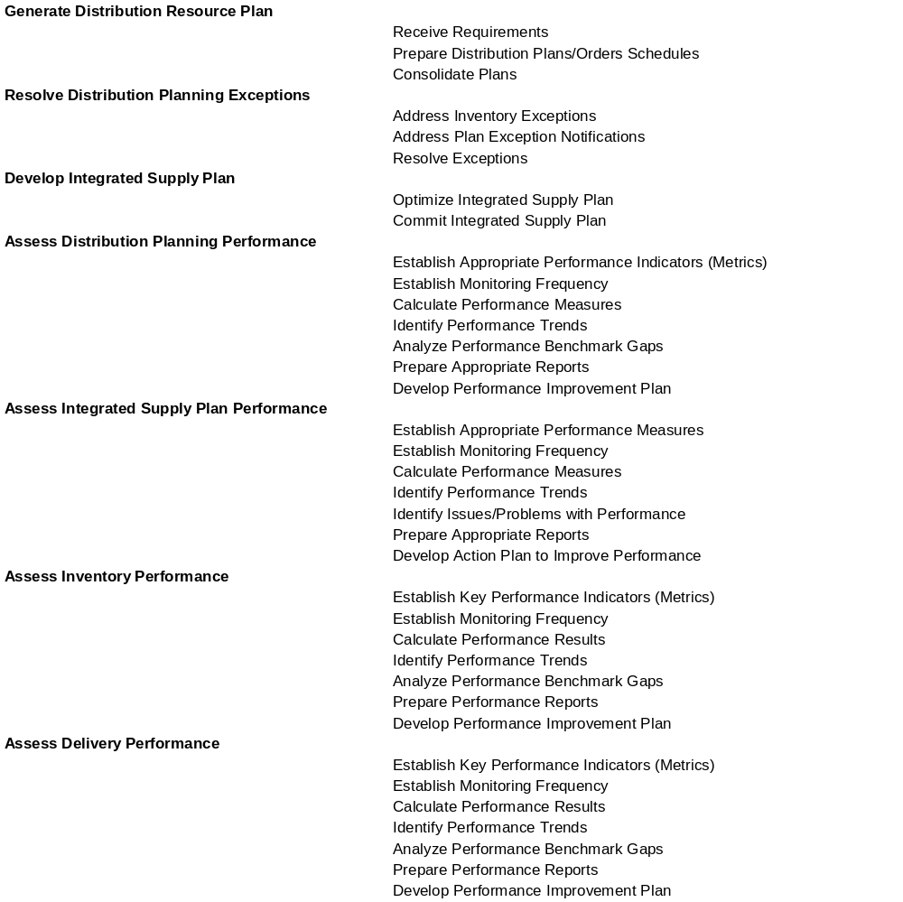
Distribution Oversight
Return to Map
Inventory and Distribution
Supply Chain Strategy
Inventory Planning
Network & Asset Configuration
Distribution Oversight
Inbound Trans-portation
Outbound Trans-portation
Distribution Center Operations
Transportation Resources
En route Inventory Management

Slide 25
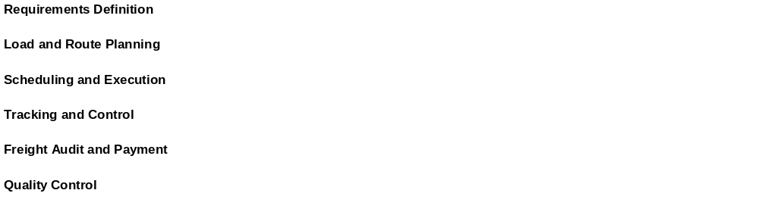
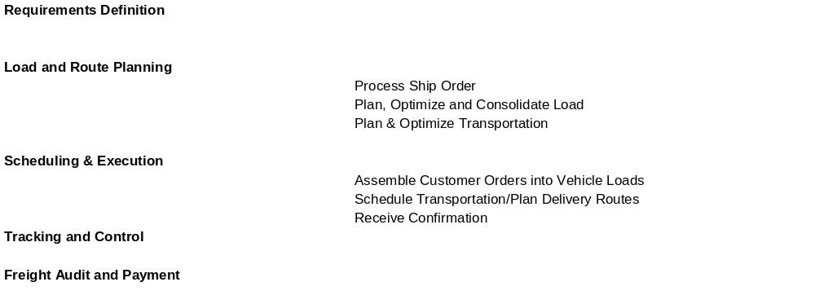
Inbound Transportation
Outbound Transportation
Return to Map
Inventory and Distribution
Supply Chain Strategy
Inventory Planning
Network & Asset Configuration
Distribution Oversight
Inbound Trans-portation
Out-bound Trans-portation
Distribution Center Operations
Transportation Resources
En route Inventory Management

Slide 26
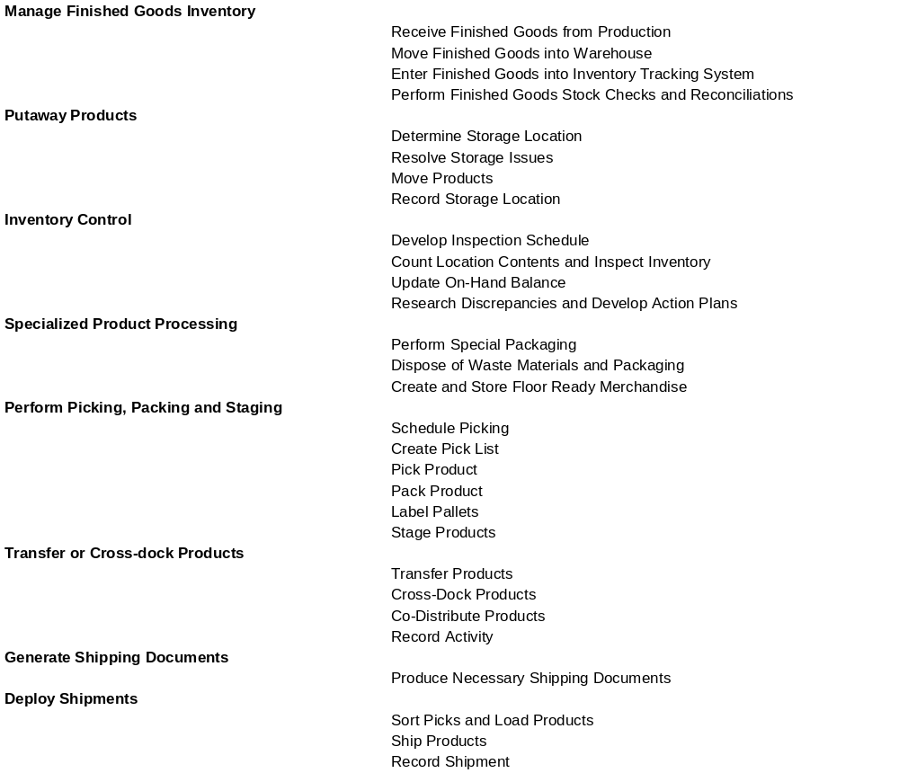
Distribution Center Operations
Return to Map
Inventory and Distribution
Supply Chain Strategy
Inventory Planning
Network & Asset Configuration
Distribution Oversight
Inbound Trans-portation
Outbound Trans-portation
Distribution Center Operations
Transportation Resources
En route Inventory Management

Slide 27


Transportation Resources
En Route Inventory Management
Return to Map
Inventory and Distribution
Supply Chain Strategy
Inventory Planning
Network & Asset Configuration
Distribution Oversight
Inbound Trans-portation
Outbound Trans-portation
Distribution Center Operations
Transportation Resources
En route Inventory Management

Slide 28

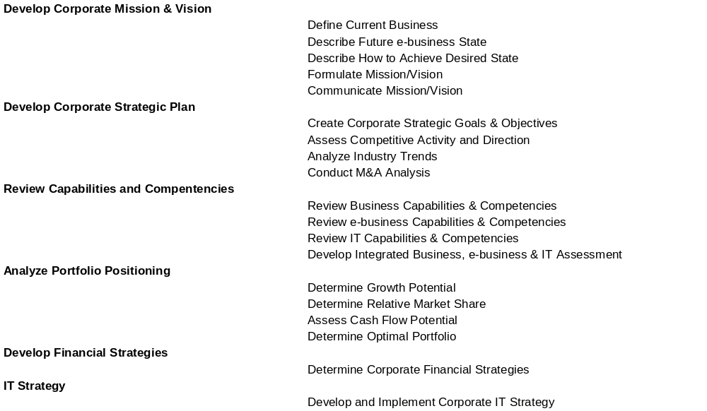
Corporate Strategy
Return to Map
Business Administration
Corporate Strategy
Corporate Planning
Alliance Management
Corporate Governance
Business Performance Management
External Market Analysis
Organization and Process Design
Legal, Tax and Regulatory Compliance
Treasury & Risk Mgmt
Financial Accounting & Reporting
Indirect Procurement
Facilities & Equip Mgmt
Resource Development
HR Administration
IT Systems & Operations

Slide 29
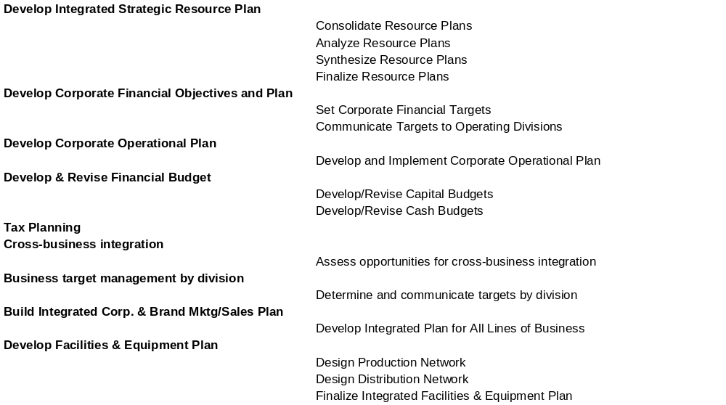
Corporate Planning
Return to Map
Business Administration
Corporate Strategy
Corporate Planning
Alliance Management
Corporate Governance
Business Performance Management
External Market Analysis
Organization and Process Design
Legal, Tax and Regulatory Compliance
Treasury & Risk Mgmt
Financial Accounting & Reporting
Indirect Procurement
Facilities & Equip Mgmt
Resource Development
HR Administration
IT Systems & Operations

Slide 30
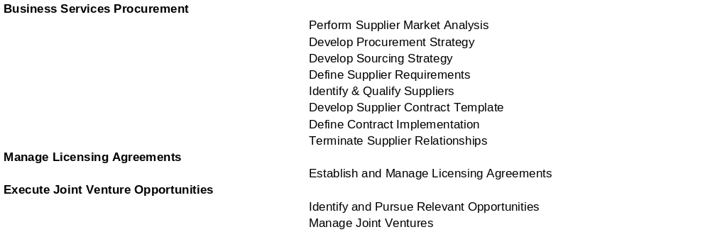
Alliance Management
Return to Map
Business Administration
Corporate Strategy
Corporate Planning
Alliance Management
Corporate Governance
Business Performance Management
External Market Analysis
Organization and Process Design
Legal, Tax and Regulatory Compliance
Treasury & Risk Mgmt
Financial Accounting & Reporting
Indirect Procurement
Facilities & Equip Mgmt
Resource Development
HR Administration
IT Systems & Operations

Slide 31

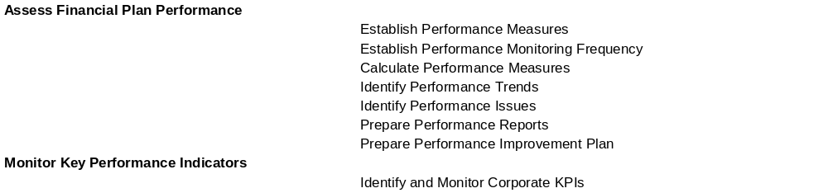
Corporate Governance
Business Performance Management
Return to Map
Business Administration
Corporate Strategy
Corporate Planning
Alliance Management
Corporate Governance
Business Performance Management
External Market Analysis
Organization and Process Design
Legal, Tax and Regulatory Compliance
Treasury & Risk Mgmt
Financial Accounting & Reporting
Indirect Procurement
Facilities & Equip Mgmt
Resource Development
HR Administration
IT Systems & Operations

Slide 32
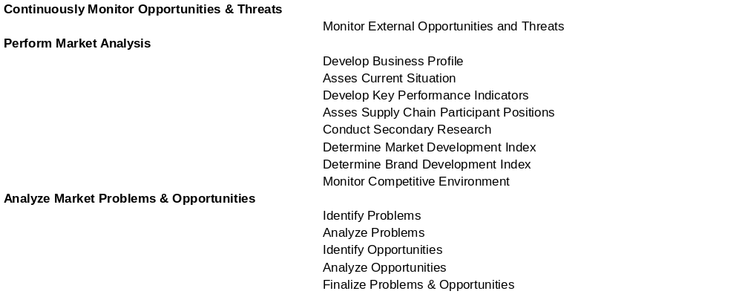
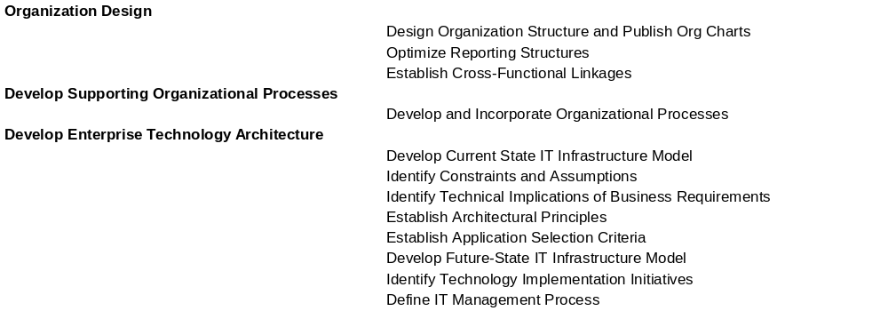
External Market Analysis
Organization and Process Design
Return to Map
Business Administration
Corporate Strategy
Corporate Planning
Alliance Management
Corporate Governance
Business Performance Management
External Market Analysis
Organization and Process Design
Legal, Tax and Regulatory Compliance
Treasury & Risk Mgmt
Financial Accounting & Reporting
Indirect Procurement
Facilities & Equip Mgmt
Resource Development
HR Administration
IT Systems & Operations

Slide 33
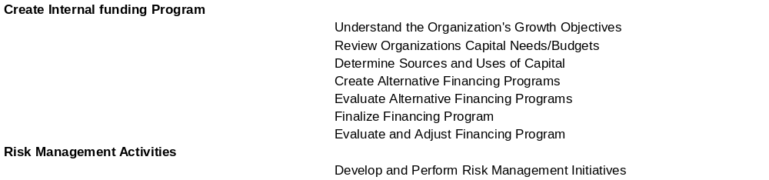
Legal, Tax and Regulatory Compliance; Treasury &
Risk Management; Financial Accounting & Reporting
Return to Map
Business Administration
Corporate Strategy
Corporate Planning
Alliance Management
Corporate Governance
Business Performance Management
External Market Analysis
Organization and Process Design
Legal, Tax and Regulatory Compliance
Treasury & Risk Mgmt
Financial Accounting & Reporting
Indirect Procurement
Facilities & Equip Mgmt
Resource Development
HR Administration
IT Systems & Operations

Slide 34

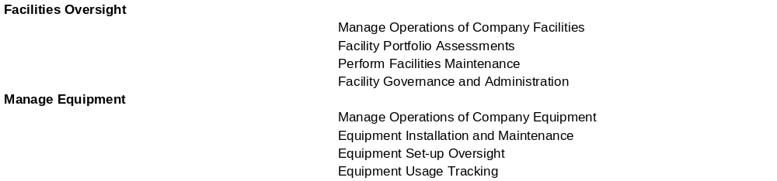
Indirect Procurement
Facilities & Equipment Management
Return to Map
Business Administration
Corporate Strategy
Corporate Planning
Alliance Management
Corporate Governance
Business Performance Management
External Market Analysis
Organization and Process Design
Legal, Tax and Regulatory Compliance
Treasury & Risk Mgmt
Financial Accounting & Reporting
Indirect Procurement
Facilities & Equip Mgmt
Resource Development
HR Administration
IT Systems & Operations

Slide 35

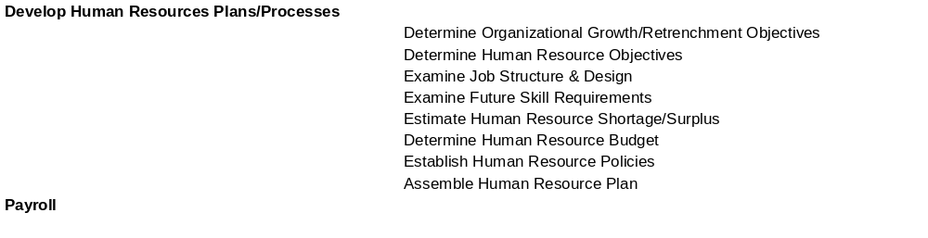
Resource Development
HR Administration
Return to Map
Business Administration
Corporate Strategy
Corporate Planning
Alliance Management
Corporate Governance
Business Performance Management
External Market Analysis
Organization and Process Design
Legal, Tax and Regulatory Compliance
Treasury & Risk Mgmt
Financial Accounting & Reporting
Indirect Procurement
Facilities & Equip Mgmt
Resource Development
HR Administration
IT Systems & Operations

Slide 36
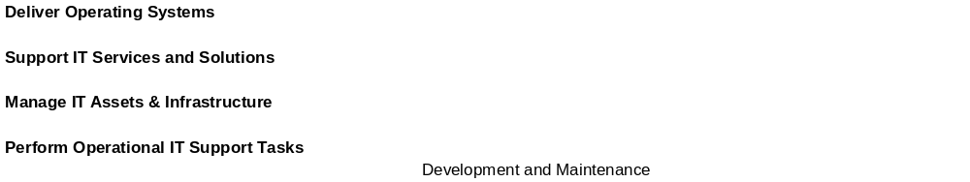
IT Systems and Operations
Return to Map
Business Administration
Corporate Strategy
Corporate Planning
Alliance Management
Corporate Governance
Business Performance Management
External Market Analysis
Organization and Process Design
Legal, Tax and Regulatory Compliance
Treasury & Risk Mgmt
Financial Accounting & Reporting
Indirect Procurement
Facilities & Equip Mgmt
Resource Development
HR Administration
IT Systems & Operations

